Slide 1
New Faculty Orientation
Fall 2021
August 24, 2021
Notes:
The Powerpoint backgrounds are locked. You are able to still adjust the text boxes. You can edit the boxes size, location, font color, font size, etc.
If you have a change request, please send a request to the Marketing and Communications request portal.
https://resources.uta.edu/business/marketing-and-communications.php

Slide 2
Agenda
Welcome and Introductions
Overview
Canvas LMS
Undergraduate Advising
Graduate Programs
PhD Program
COB Research
DREI Initiatives
Physical/Virtual Classroom
Digital Measures
Library Resources
Logistics of Teaching

Slide 3
Introductions
Greg Frazier, Senior Associate Dean

Slide 4
Welcome
Harry Dombroski, Dean

Slide 5
Overview of UTA & CoB
Fall 2020: UTA—almost 42,700 COB--6,250 (15%)
COB: 6 academic depts., 11 UG majors, 13 masters, 6 PhD majors, several certificate programs
SACS and AACSB accredited (Passed in Spring 2021)
Top Carnegie classification for doctoral research univ.
Just approved as latest Texas Tier 1 Research Univ.
New budget model at UTA
DREI Initiatives

Slide 6
Canvas LMA
Christy Spivey
Clinical Associate Professor, Economics
Program Director, MS in Economic Data Analytics
COB Canvas Champion
cspivey@uta.edu

Slide 7
Canvas Resources
Canvas
uta.instructure.com
COB Teaching Hub
https://uta.instructure.com/courses/63768
UTA Canvas Resources
https://www.uta.edu/administration/provost/policies-and-resources/canvas/faculty-training-resources

Slide 8
Canvas Resources
Canvas Instructor Guide
https://community.canvaslms.com/t5/Instructor-Guide/tkb-p/Instructor
Canvas Support
Access this 24/7 via chat or phone through the question mark icon on the global navigation menu
Our campus Canvas guru is Joseph Rutledge at CDE joseph.rutledge@uta.edu

Slide 9
Service Now
Service Now https://uta.servicenow.com/selfservice
By submitting a ticket directly through Service Now your request or issue report will be quickly routed to the appropriate department
Create a ticket in just a few easy steps. From the Self Service page:
Log in to Service Now
Click Report an Issue or Request Something
Complete the form
Use to request an empty shell or master course shell for Canvas

Slide 10
Syllabus
Use the Upload Syllabus feature and that will automatically drop your syllabus document onto the Syllabus page, Digital Measures, and Mentis

Slide 11
Undergraduate Advising
Shelly Parker
Director, Undergraduate Studies
sbparker@uta.edu

Slide 12
Undergraduate Degree Programs
Bachelor of Business Administration (BBA)
Concentrations in:
Accounting
Economics
Finance
Information Systems
International Business/
Foreign Language
Management
Marketing
Real Estate
Operations & Supply Chain Management
Bachelor of Science (BS)
Accounting
Business Analytics
Economics
Information Systems

Slide 13
Undergraduate Advising Staff
Front Office Staff
Julia Baker Current Search
Receptionist Administrative Assistant
Business Building, Suite 107
https://www.uta.edu/academics/schools-colleges/business/undergraduate-advising
ugadvise@uta.edu
817-272-3368

Slide 14
Undergraduate Advising Staff
ADVISORS (Alpha Group) OTHER STAFF
Micah Washington (A – B) Jasmine Coker (Degree/Graduation Advisor)
micah.Washington@uta.edu jasmine.young@uta.edu
*In training
Kathy Gutierrez (C – D)
kathy.Gutierrez@uta.edu Bianca Upshaw (TCC Advisor) bianca.upshaw@uta.edu
Denise Hayes (E – G)*
dwylie@uta.edu Bertram Dugan (Assistant Director)
*Goolsby Leadership Academy Advisor bertram@uta.edu
*Works also with the Director of Goolsby Leadership
Ramon Iturbe (H - J)
ramon.Iturbe@uta.edu Shelly Parker (Director)
sbparker@uta.edu
Milaun Mack (K – L, N)
milaun.mack@uta.edu
Brianna Gibbs (M)
brianna.gibbs@uta.edu
Linda Letherwood (O – R)
linda.letherwood@uta.edu
*Almost done with training
Ellen Long (S – T)
ellen.long@uta.edu
*Will be moving into new Probation Advisor position
Adrienne King (U-Z
*In training, other advisors are seeing these students

Slide 15
Undergraduate Connection
Now through Census Day (September 10th), advisors are seeing students on a drop in basis.
Virtual (Monday – Wednesday – Friday)
In Person (Tuesday – Thursday)
All staff will be working a hybrid model for Fall 2021 with the office staffed Monday – Friday
Students will be offered the option of in person or virtual advising services
If you have any questions regarding a student or a policy/procedure, please contact Shelly Parker at sbparker@uta.edu

Slide 16
About Graduate Students
Scott Elbert
Director of Graduate Business Services
scott.elbert@uta.edu

Slide 17
Graduate Programs
Master of Business Administration
Flexible format (Main Campus)
Professional Cohort format (Fort Worth Center)
Weekend format (Main Campus)
Master of Professional Accounting
M.S. in Accounting
M.S. in Business Analytics
M.S. in Taxation
M.S. in Economic Data Analytics
M.S. in Health Care Administration
M.S. in Human Resource Management
M.S. in Information Systems
M.S. in Marketing Research
M.S. in Quantitative Finance
M.S. in Real Estate
Executive Master of Business Administration
Ph.D. in Business Administration

Slide 18
Frequently Asked Questions
Dropping & Adding Classes
Deadlines
Signatures or permission by email
Student responsibility
Form
Instructor Enrollment Decision
Enrollment beyond Course Capacity
Enrollment without Prerequisite Coursework
Face-to-Face Course Virtual Participation
Students Not Fully Admitted/Unable to Register
Grades
Incomplete “I”
Academic Standing Needs

Slide 19
What to Send to Graduate Business Services or Advisors
Issues Regarding Degree Completion
Course Drop Recommendations
GPA Issues
Signatures for CPT/OPT, Internships, etc
Administrative/Graduate Policy Questions

Slide 20
PhD Program
Terry Skantz
Director of PhD Programs in Business
Associate Professor of Accounting
tskantz@uta.edu

Slide 21
Our PhD Programs
Management – Myrtle Bell
Marketing – Ritesh Saini
Management Science/Ops – Kay-Yut Chen
Information Systems – Jinggou Wang
Accounting – Bin Srinidhi
Finance – David Rakowski

Slide 22
PhD Student Funding
Many students get DDA for 4 years
$24k + tuition in Spring/Fall
Year /unfunded students $1000 scholarship + nonresident waiver
Carla Buss Memorial Scholarship (annual)
COB Dissertation grants (every semester)
Up to 2k for research expenses
Graduate School Offerings
Dissertation Research Enhancement Grant—up to $2k
Dissertation Fellows Program

Slide 23
Research in the College of Business
Wendy Casper
Associate Dean for Research
Peggy E. Swanson Endowed Chair &
Distinguished Research Professor
wjcasper@uta.edu

Slide 24
Internal Research Funding
COB Internal Grant Programs
(1) COB Research Grants, each semester, up to $5k in direct expenses
(2) COB Impactful Research Grants, up to $10k in direct expenses
UTA Research Enhancement Grant
Campus-wide, due annually in November
Maximum $10k
Contact Ann Cavallo, cavallo@uta.edu
Interdisciplinary Research Program
Maximum $20k
Must include faculty from multiple colleges at UTA
Themes: Health and the Human Condition, Sustainable Urban Communities, Global Environmental Impact, and Data-Driven Discovery
Annual CFP

Slide 25
Other Relevant Research Topics
Journal lists
Developed by departments
Elite, Near Elite, High Quality, Quality
Ask your department chair
Guidelines available to make a case to get credit for non-business publication outlets
Elite = course release + $5k research funds, Near Elite = $2k research funds
Faculty committee considering guidelines for post-tenure course load variability linked to research

Slide 26
DREI Initiatives
Myrtle Bell
Associate Dean for Diversity, Racial Equity, & Inclusion
Thomas McMahon Professor of Business Ethics
mpbell@uta.edu

Slide 27
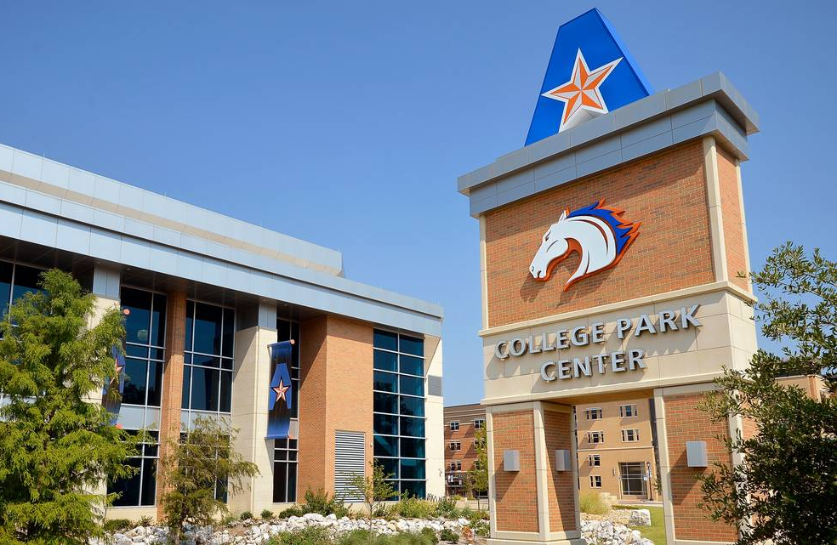
Students in the University and College of Business are extremely diverse
Hispanic-Serving and Asian American and Native American Pacific Islanders-Serving Institution
UTA graduates most African-American undergraduate and Master’s students in Texas
#1 Top Business School with most U.S. minorities (Poets & Quants, 2021)
College of Business Student Population
28% Hispanic, 24% White, 16% Asian, 11% African American,
18% International, 3% Multi-racial; 48% Female
Average Age: 25.5 years
28% of students have gross family income < $20,000
44% Pell grant eligible
Diversity, Racial Equity, & Inclusion Goal
Be the university of choice for organizations seeking diverse business students who are knowledgeable about diversity among applicants, employees, customers, and constituents and have tangible skills for working in diverse environments.

Slide 28
Outstanding, resilient students
SHRM Foundation Scholarship winners (1/43 nationwide) two years in a row.
CPA testing success:
UTA: 50.4% pass rate, Avg age 32.1
UTD: 47.5% pass rate, Avg age 29.4
UNT: 43.4% pass rate, Avg age 32
SMU: 56.3% pass rate, Avg age 25.7
TCU: 67.3% pass rate, Avg age 25.7
In 2019, two of the top 137 scoring CPA exams out of all 75,000 test takers were UTA students.
MSHRM program ranked top 5 or 6 in nation.
Notes:
95.5 on all four parts of the CPA, in first sitting. Elijah Watts Sells award. https://www.aicpa.org/press/pressreleases/2020/aicpa-recognizes-top-2019-cpa-exam-performers-with-elijah-watt-sells-award.html

Slide 29
Student DREI Council
Applications Starting Fall, 2021
Tremendous student interest
Cohort-based classes to begin Spring 2022
Diverse students across disciplines
Mentoring
Peers; Faculty, Staff, and Administrators; Diversity Partners
Internships
Diversity Certificate

Slide 30
DREI Faculty & Staff
Council: Faculty & Staff Members across COB
Accounting, Economics, Finance, Marketing, Management, Information Systems
Academic Branding
Marketing Communications
DREI Group: Faculty studying diversity-related content across college departments
Philisa Stanford, DREI Director, philisa@uta.edu

Slide 31
Diversity Certificate – Fall 2021
Diversity education - formal efforts to enable development of awareness, knowledge, and skills to effectively work with, work for, manage and serve diverse others in various contexts.
Marketable skills
Diversity Certificate Courses in College of Business:
Diversity in Organizations Work and Disability
Multicultural Marketing Economics of Discrimination
International Management International Marketing
Other content in included in Accounting, Finance, Economics, Management, Marketing, Real Estate Courses
Include diversity content in your classes
Let your students know about the certificate.

Slide 32
Contact me to engage with DREI in the college:
Myrtle Bell
mpbell@uta.edu

Slide 33
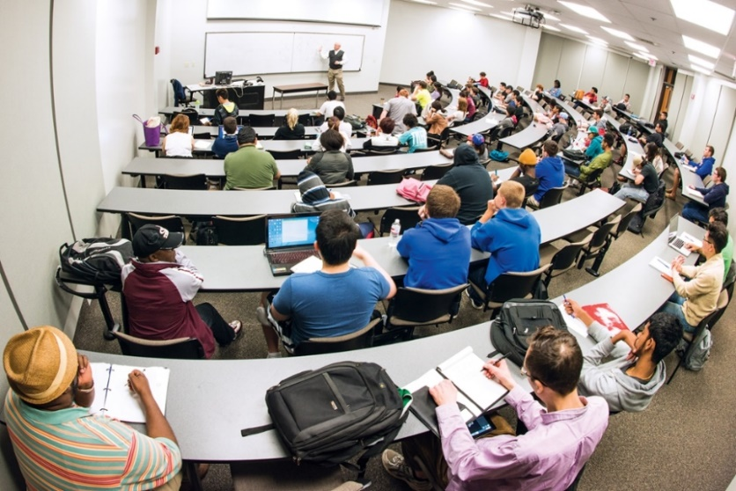
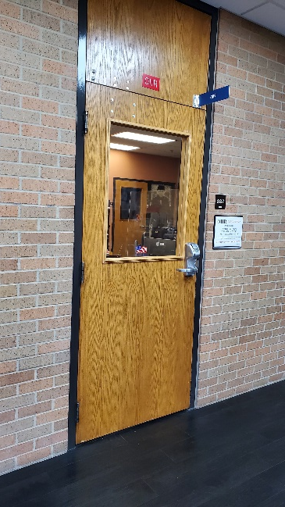
OIIR Office of Information and Instructional Resources
Jairo Omaña-Peñaranda
jairo@uta.edu
Wade Mathis
wade.mathis@uta.edu

Slide 34
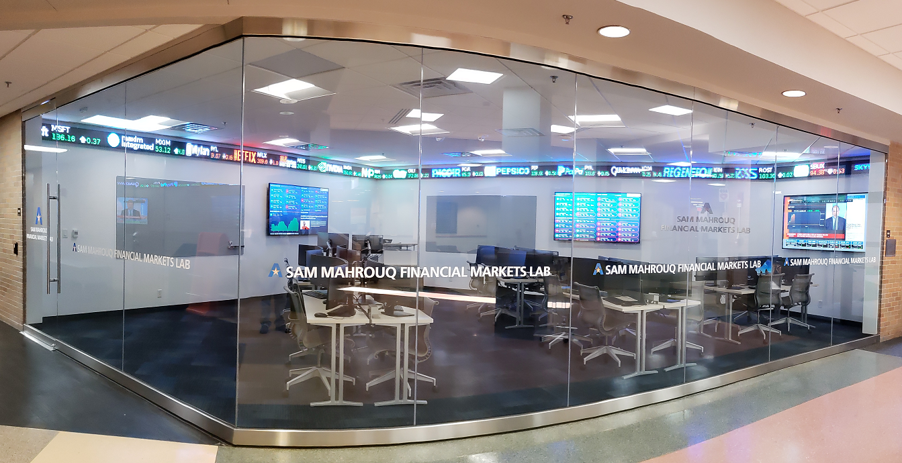
The Physical Classroom
Card Swipe/Door Propping
Emergency Evacuation/Safety & Security
Classroom Technology (Login, Projectors, Lecture Capture)
How to use
New Equipment / Control System
Student Computer Labs
(OIT: Room 336 - OIIR: Rooms 339 and 349)
Behavioral Lab (Room 350)
MSMR Lab (Room 246)
Sam Mahrouq Financial Markets Lab (Room 136)

Slide 35
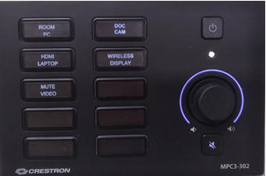
The Physical Classroom
The XPanel has been replaced by a new system:
To turn on/off the projector, press the power button on the Crestron Control Panel (pictured).
The panel is fixed to the desk and not movable.
To display the desired image on the projector screen, press the button for the appropriate input (Room PC, HDMI Laptop, Doc Cam, Wireless Display).

Slide 36
The Physical Classroom
Whom to contact?
CoB Classroom / Lab Support:
OIIR: 2-5230 or oiir-team@uta.edu
Facilities Management: 2-2000 or www.uta.edu/fixit (work orders maintenance, A/C - Heater issues)
ECHO 360: Don Lane – dklane@uta.edu
UTA Police (non-Emergency): 2-3381

Slide 37
The Remote Classroom
Resources for Remote Classes:
https://oit.uta.edu/utaremote/
ECHO 360 Classrooms:
142, 147, 149, 151, 152, 153, 154, 243, 252, 254, and 256
OIIR Labs: Rooms 339 and 349
Canvas, Teams, ECHO Universal Capture.
…Q&A

Slide 38
Digital Measures
Academic Brand Management
Mick Lewis, Director
lewiss@uta.edu
2-9135

Slide 39
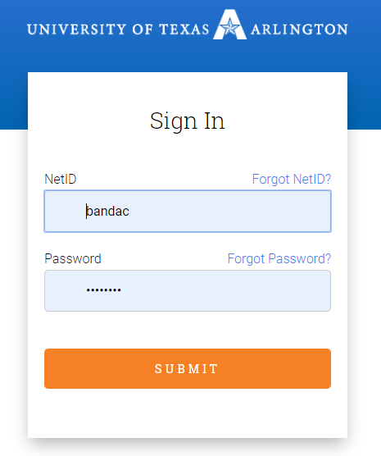
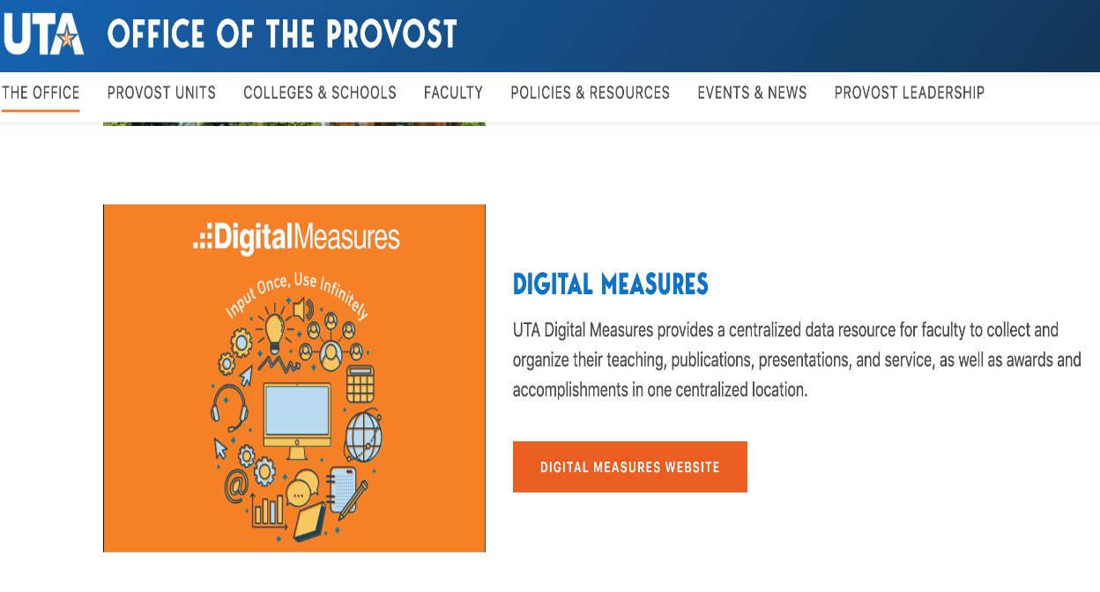
Logging in to DM
Step 2: Enter your NetID and Password and click submit
Step 1: From the provost website click “Digital Measures“ and then “UTA DM Login“

Slide 40
Uploading CV

Slide 41
DM Training and Tutorials
Updating Records
Importing Publications via Third Party
Workflow for Tenure and Promotion
Running Reports
https://www.uta.edu/administration/provost/policies-and-resources/digital-measures/tutorial-and-trainging-dates

Slide 42
Academic Brand Management
Digital Measures Support
Institutional Data
Grade Distributions
Degree Conferrals
Demographic Analysis
Graduation Application Reports
Unit effectiveness & assurance of learning

Slide 43
Partner with the Library
Explore open education (grants available)
Data management & vis. support
Archive works to increase citations
Collaborate in the classroom
Course reserves
Business Databases
Contact: Andy Herzog
amherzog@uta.edu

Slide 44
The Logistics of Teaching
Fernando Jaramillo Associate Dean for Students and Programs Jaramillo@uta.edu

Slide 45
The Logistics of Teaching: Faculty
Office hours and email
Online teaching expectations (Quality Matters)
When faculty need to miss class/exam
Syllabus template – Provost’s website each summer
Teaching evaluations, peer reviews, and performance evaluations
Class attendance, class roll accuracy, grade changes, grades of ‘F’
Student conduct and academic integrity

Slide 46
The Logistics of Teaching: Students
What to handle yourself and what to refer to others
Excused absences (sports, military, religious)
Grading and grade inflation
Entering Grades (4-week, midterm, final) in Canvas
Request for Grade of ‘Incomplete’
Grade Appeals--process
Disabilities
Advising

Slide 47
Q & A Have a great year!!
Hungry yet?

